Slide 1

UTABIRI

Slide 2
Problem
Inefficient weather and agronomic support from seed companies to agrovets leading to low sales for both of them.

Slide 3
Proposed Solution
Targeted weather and agronomic support system for seed companies & agrovets based on farmer data collected from agrovets

Slide 4
Solution

Slide 5
demo
Interactive Platform between company and agrovet:
farmer profiles & agrovet profiles
Crops grown in an area
Advice agrovets on what type of seed to stock up.
Push notification through SMS and android notifications

Slide 6
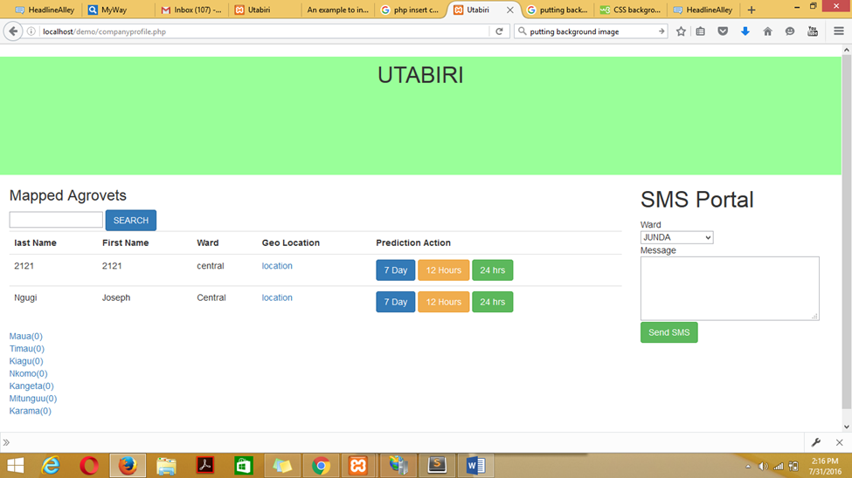
Dashboard

Slide 7
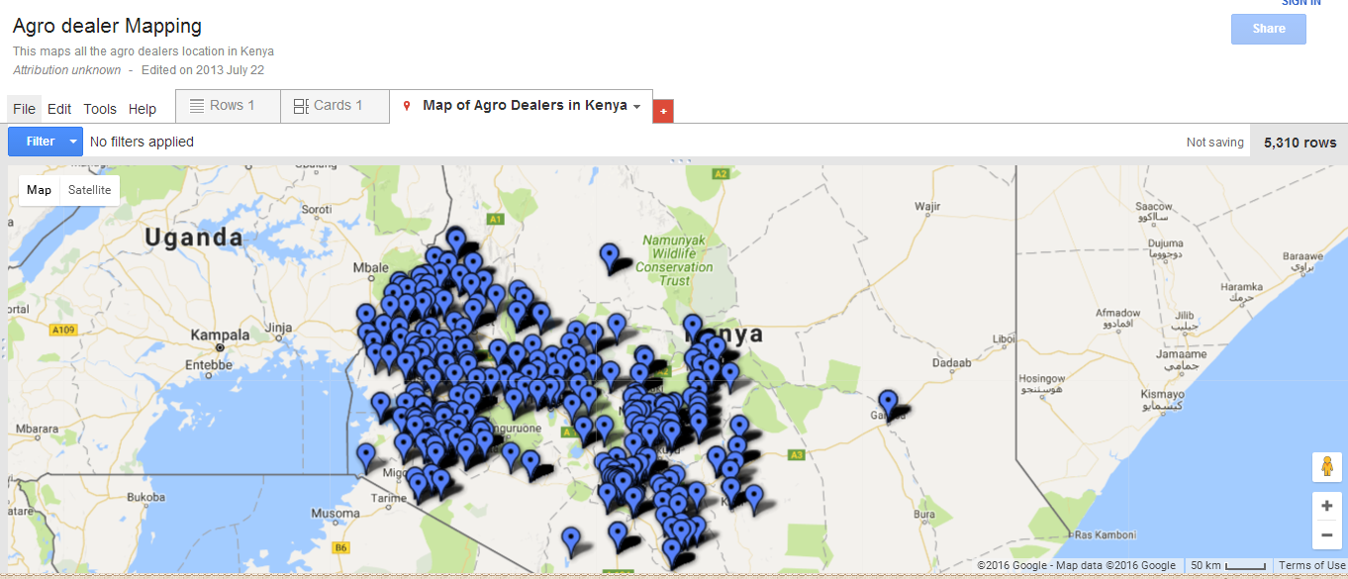
Agro dealer mapping

Slide 8
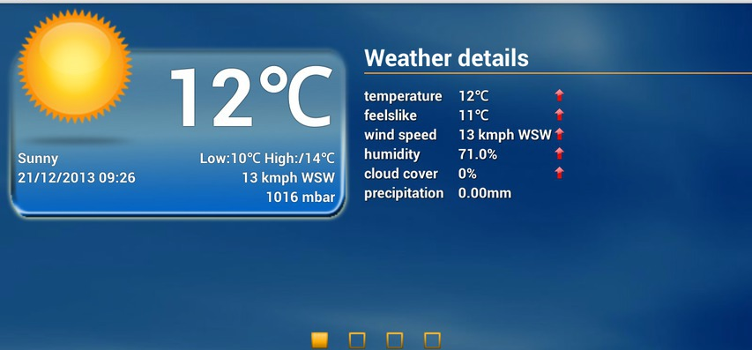
Example of weather data

Slide 9
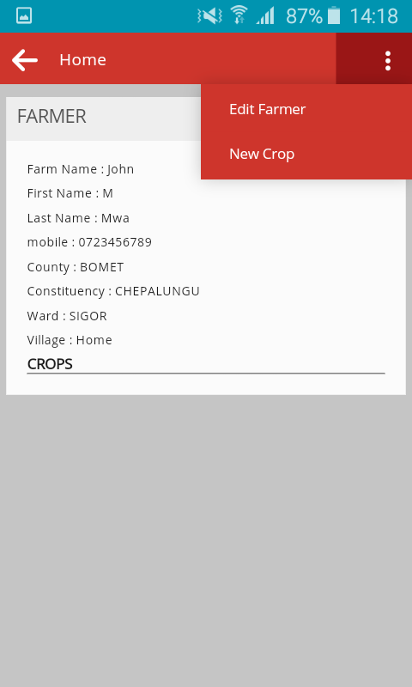
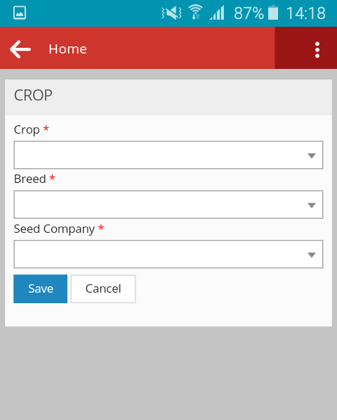
Farmer data
The data is collected using mobile app or structured sms (shortcode)

Slide 10
Impact
Consumer based approach to uptake of weather data
Incentive for agrovets to uptake services of seedcos
Targeted sales campaigns to have a more successful conversion rate for the seed companies.
Faster communication and linkage between seedcos and paying customers

Slide 11
Business model
Income
Dashboard Subscription by seedcos
Notification( app/SMS) to agrovets & Farmers
Further development – Non Seed companies pay for this data

Slide 12
Questions

Slide 13
Utabiri Group members: Joseph Ngugi Kelvin Kagia Edwin Mshila Diana Sagon John Muchori Mburu Njunge Eric Karanja Catherine Mwikali

